Slide 1
EE4202 Database Systems
VISUAL PARADIGM COMMUNITY EDITION TOOL

Slide 2
VISUAL PARADIGM TOOL
https://www.visual-paradigm.com/download/community.jsp
https://online.visual-paradigm.com/app/diagrams/

Slide 3
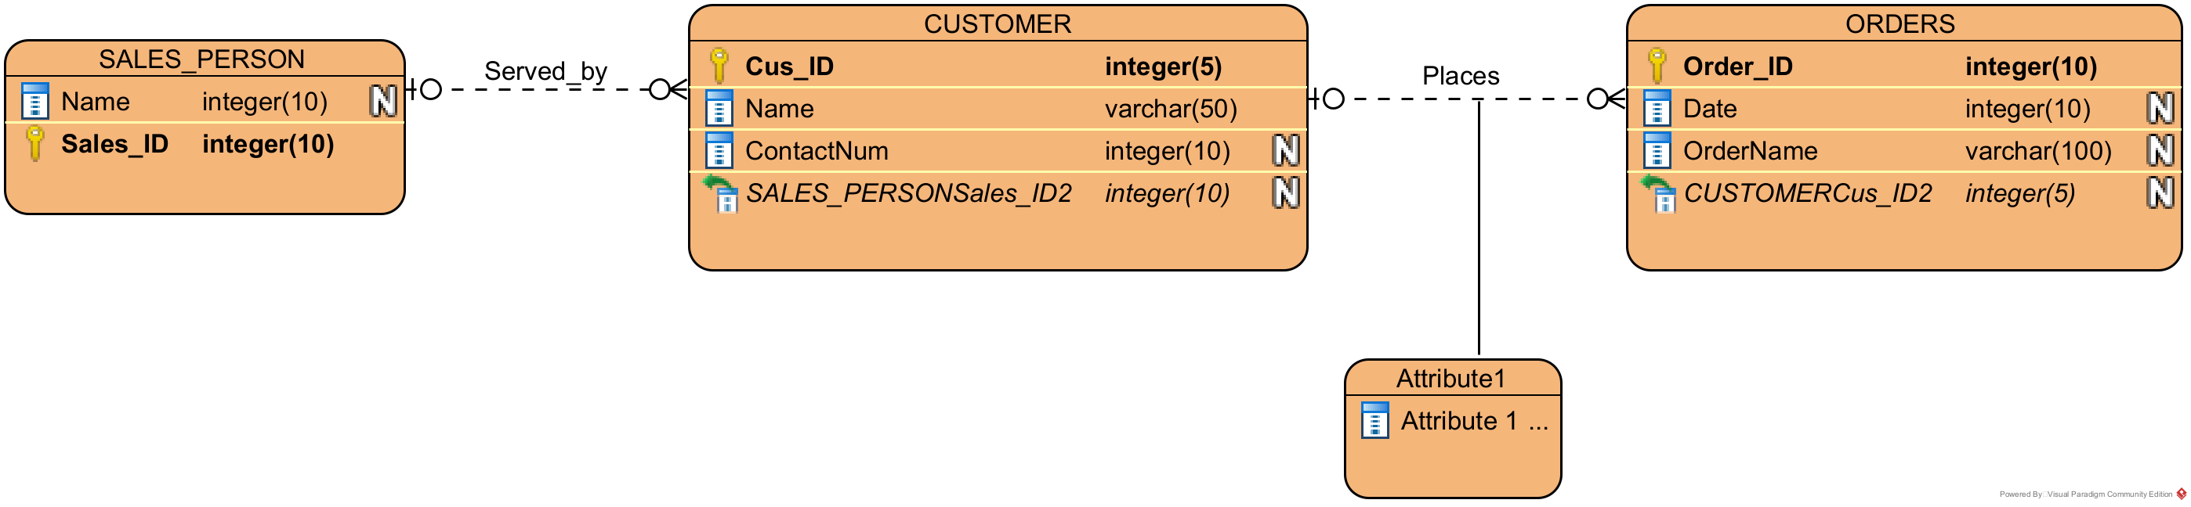
VP ER DIAGRAM

Slide 4
UML NOTATION
ER diagram | UML class diagram
Entity Type | Class
Attributes | Properties
---------------- | Operations
Relationship type | Association
Relationship instance | Link
Relationship constraints | multiplicities
Recursive relationship | Reflexive Association
Identifying relationship | Qualified association
UML stands for Unified Modeling Language.
UML class diagram is an alternative notation to ER diagram
Operations are functional requirements which are not shown in ER diagrams.
CLASS1
CLASS2
Property1
Property2
Property3
Property1
Property2
Property3
X1..Y1
ASSOCIATION
X2..Y2
operation1
operation2
operation1
operation2

Slide 5


RELATIONSHIPS BETWEEN CLASSES IN UML CLASS DIAGRAM
Aggregation: The structural constraint (0,1) of object(entity in ER model) which maps to 1 in a many to one mapping(entity having side 1 in an association of N:1 cardinality ratio) can be represented using an empty diamond instead of (0,1) in UML class diagrams. Meaning is objects at the opposite side aggregates at the diamond side. Ex: Many children aggregating to one parent employee.
Emp_ID
First name
guardian
DEPENDS_ON
(0,1)
(1,N)
dependant
EMPLOYEE
CHILD

Slide 6
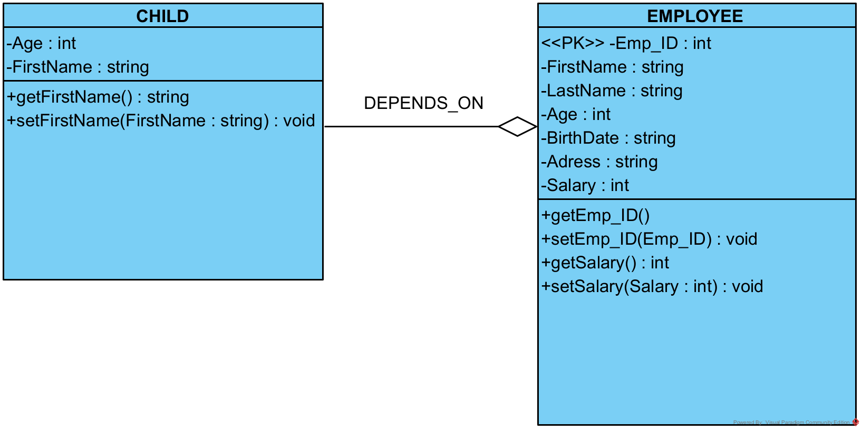
VP UML CLASS DIAGRAM

Slide 7

RELATIONSHIPS BETWEEN CLASSES IN UML CLASS DIAGRAM
Composition: The structural constraint (1,1) means composed of exactly one. That means every object(entity in ER model) in opposite end of the association is composed/associated with exactly one object in the black diamond end.
Ex: one or many employees working for exactly one department
employer
WORKS_FOR
(1,1)
(1,N)
worker
DEPARTMENT
EMPLOYEE

Slide 8
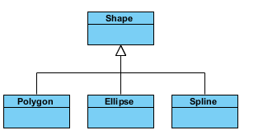
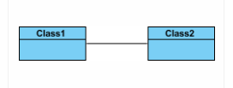

RELATIONSHIPS BETWEEN CLASSES IN UML CLASS DIAGRAM
Inheritance (or Generalization):
Represents an "is-a" relationship.
Polygon, Ellipse and Spline are derived from Shape Class.
Association
- Associations are relationships between classes in a UML Class Diagram.
- Associations are typically named using a verb or verb phrase
Aggregation
- It represents a "part of" relationship.
- Class2 is part of Class1.

Slide 9


Composition
- A special type of aggregation where parts are destroyed when the whole is destroyed.
- Objects of Class2 live and die with Class1.
- Class2 cannot stand by itself.
Dependency
- Exists between two classes if the changes to the definition of one may cause changes to the other (but not the other way around).
- Class1 depends on Class2

